Slide 1
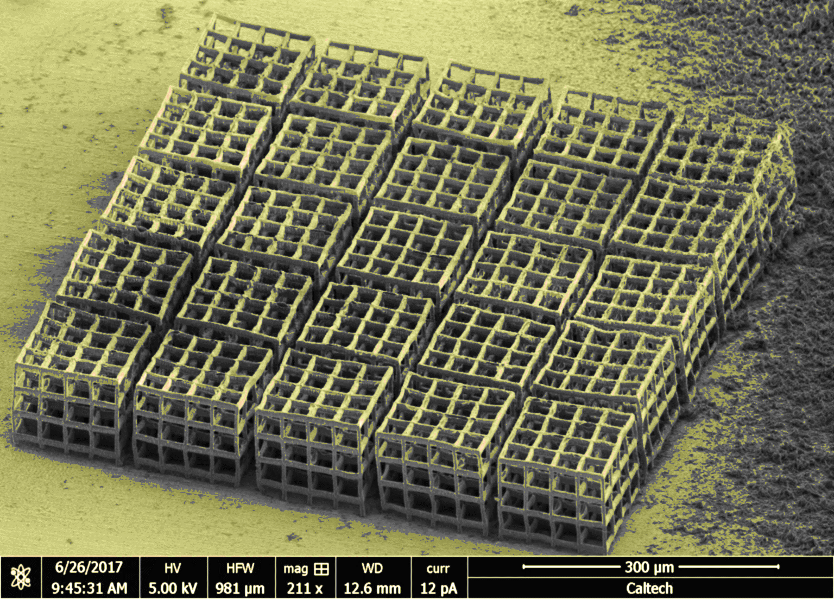
Developing Next-Generation 3D Microbatteries, via Two-Photon Lithography
8/10/2017
Nima Leclerc [1], Michael Citrin [2], Julia Greer [3]
nl475@cornell.edu [1] , mctrin@caltech.edu, [2] jrgreer@caltech.edu [3]

Slide 2
Outline:
Motivation
3D Microbattery Fabrication
Electrodeposition Results and Discussion
Side Projects, Summary, and Future Work
What’s in a battery? How does it operate?
- Primary vs. Secondary
-Cathodes, anodes, electrolytes
-Power vs. energy density
M. Park, et al., J. Power Sources (2010)
Notes:
Here is an outline of the discsussion for you to read over.
Before delving into our research findings, lets first dicuss mechanism and components of a battery cell.
Firstly, let’s take a look at this schematic depicting a Li ion battery. These are one class of secondary batteries, also known as reversible batteries, for the half reactions at each electrode are reversible. In contrast, a primary battery is one that is not reversible. This battery comprises an a current collector, allowing charge to flow into/out of the device, cathode and anode layers which enable the potential difference across the cell and an electrolyte layer in between which allows for Li ion or electronic transport bewtween the two electrode materials.
It’s also importatnt to note two properties of batteries: power and energy density. You can imagine power density as a measure of the charge/discharge rate of a battery. A higher power density corresponds to a shorter transport length. Energy density on the other hand, is defined by the cell’s total energy per footprint area. A larger mass loading in a battery will deliver a higher energy density.

Slide 3
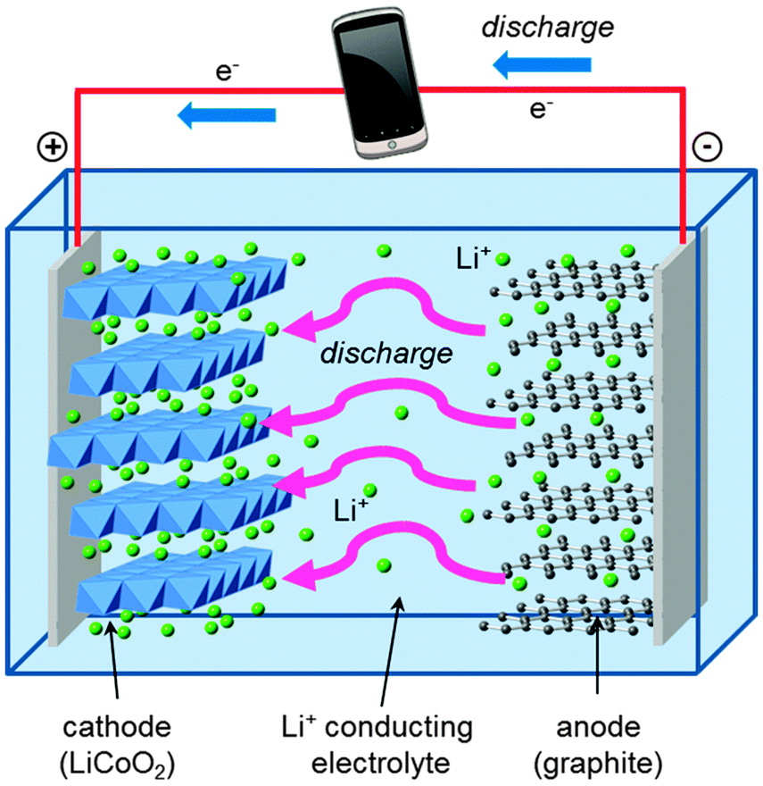

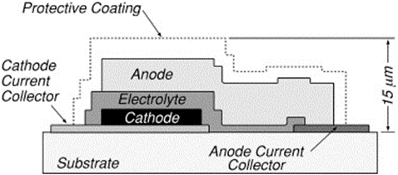
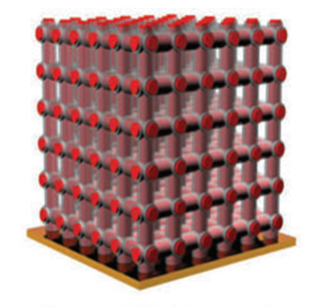
Problem: Current Batteries sacrifice Energy Density w/ Increased Power Density
Li Ion Battery
Thin-film SSBs
3D SSBs
Organic solvent electrolyte
Low E/P densities
Dendrite failure mechanism
Large transport lengths
LiPON solid electrolyte
All solid-state!
Small transport lengths
High E/P densities
All-solid state !
Uses height to increase E density
Small size → biomedical devices
Chem. Soc. Rev., 2014, 43, 185-204
Materials Sci. and Engi., 2005, 116, 245-249
Notes:
Let’s now discuss the progression of battery technology, starting with the Li ion battery. As many of you know, this is a secondary battery. However, a myriad of flaws exist within it due to its organic solvent electrolyte. First, the fact that the electrolyte is liquid state means that it can contriute to the intense failure mechanism, observed frequenty. Where, a Li dendrite wire from one electrode can penetrate across the cell, hence shorting the battery. This is common, for there is no mechanically robust barrier preventing the dendrites from penetrating.
Additionally, the use of flammable organic solvents can occasionally incite these batteries to catch on fire.

Slide 4
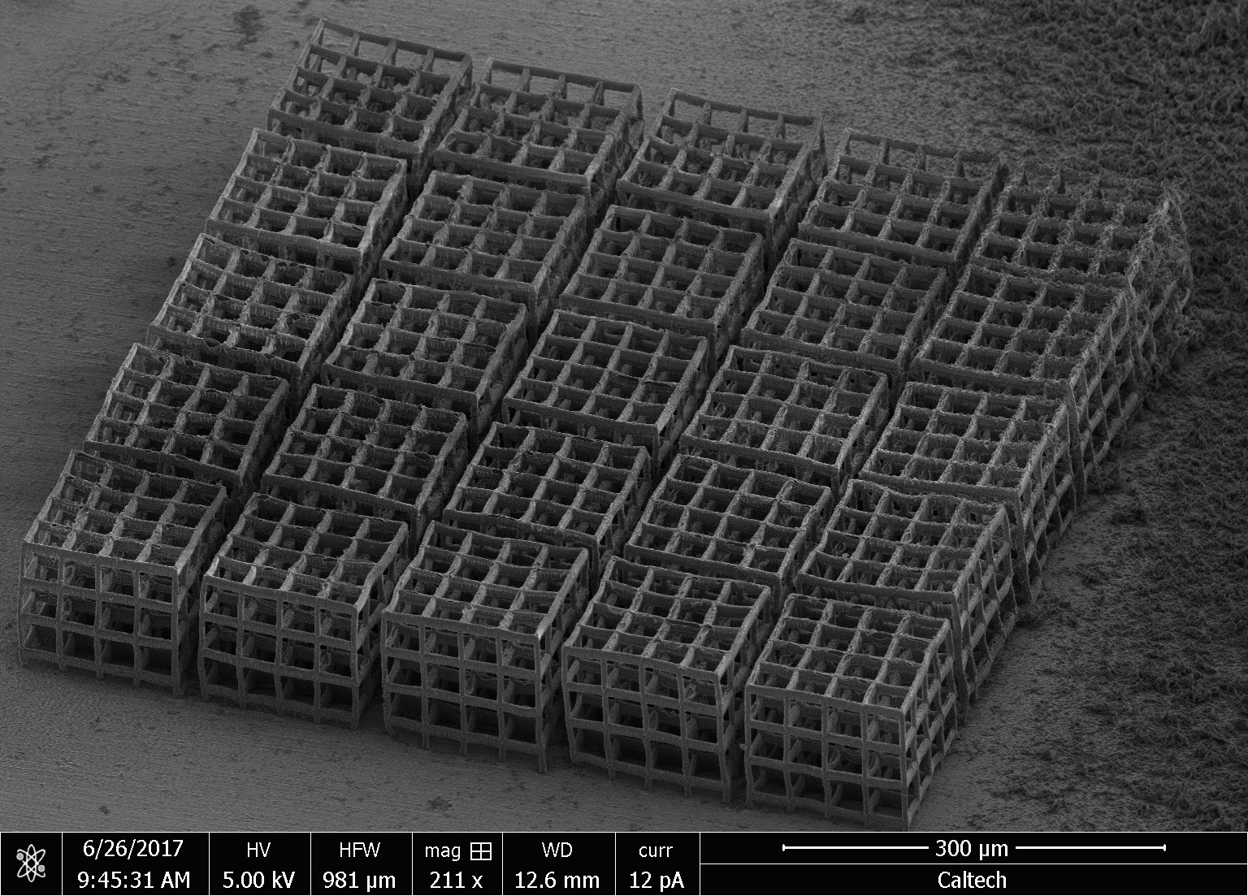
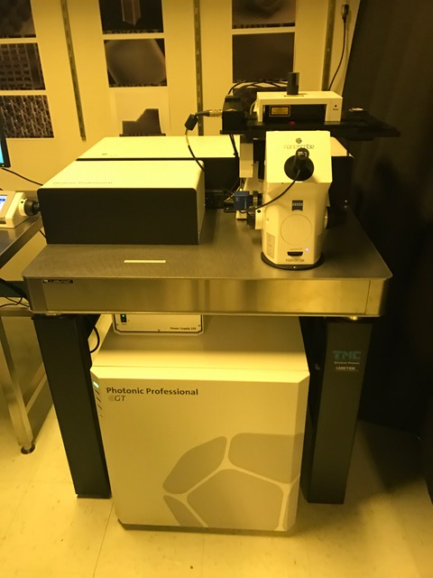
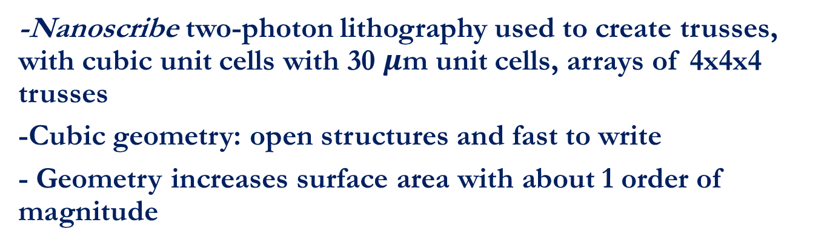
Nanostructure Fabrication
-Nanoscribe two-photon lithography used to create trusses, with cubic unit cells with 30 $μ$m unit cells, arrays of 4x4x4 trusses
-Cubic geometry: open structures and fast to write
- Geometry increases surface area with about 1 order of magnitude

Slide 5
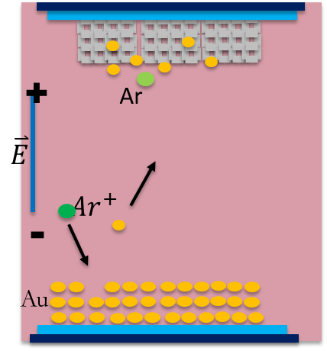
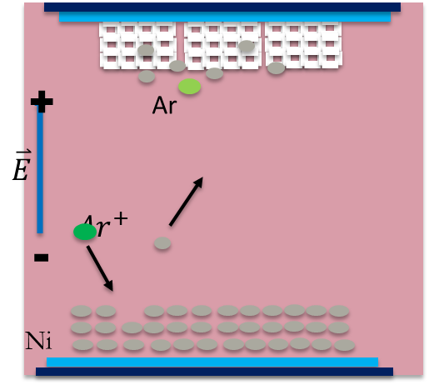
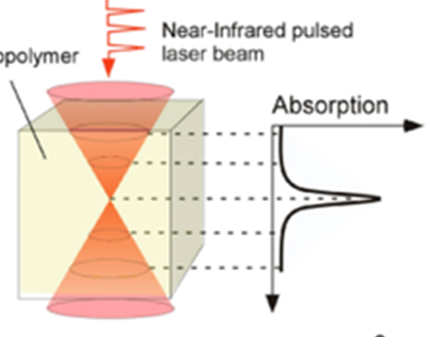
Fabrication Process
Nanolattice Fabrication, via Two-Photon Lithography
Ni deposition, via sputtering
Au deposition, via sputtering
Maruo, S. and Fourkas, J. (2008), Recent progress in multiphoton microfabrication. Laser & Photonics Reviews, 2: 100–111.
Notes:
Li won’t adhere → we need an adherent→ we use gold b/c it is soluble in Li (it lowers E_a , solubility is more favorable)

Slide 6

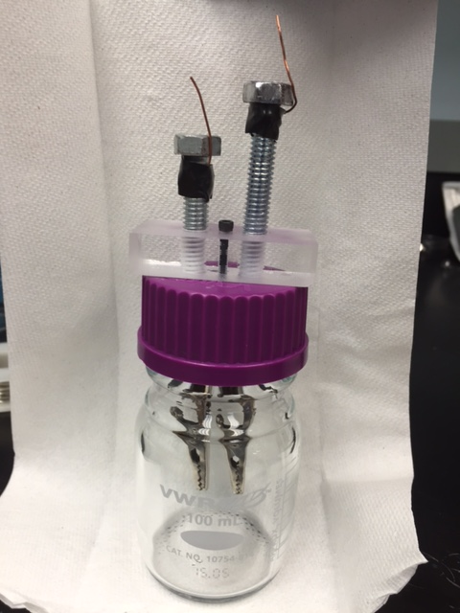
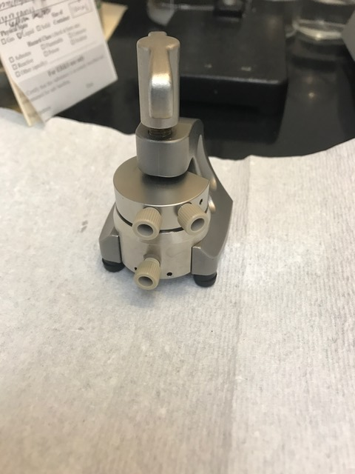

Electroplating Li anode
Containment: beaker cell and EL-CELL
Less electrolyte → less impurities→ ☺
Electrolyte: Propylene carbonate, CsPF6, LiClO4
Electrolyte
$$Li^{+}$$
Li
V
Notes:
The subsequent step, was depositing the Li anode onto the truss, via electrodeposition. Here, the tru
100 uL
Impurities: H2O and O2

Slide 7
Minimizing Dendrite Formation
Cesium additive, forms Self-Healing Electrostatic Shield (SHES)
Low currents
Increased temperature
J. Am. Chem. Soc. 2013, 135, 4450−4456
Cs^+
Notes:
Cs coats the rough regions of the substrate, hence forming SHES
This coating encourages away any incoming Li , due to coloumbic repulsion
Cs in solution at a low enough concentration, such that they have a low enough reduction potential → does not plate Cs
Reduces dendrite formation
Compare the two
Ji-Guang Zhang Pacific Northwest National Laboratory

Slide 8
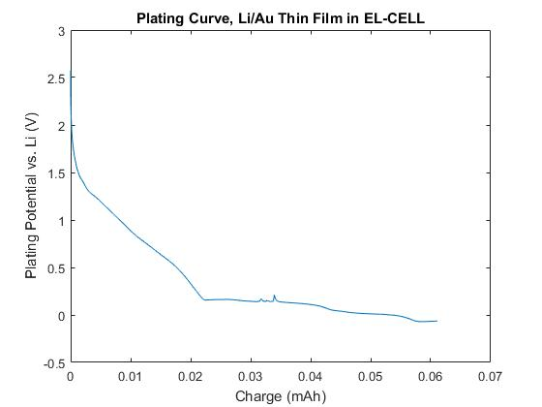
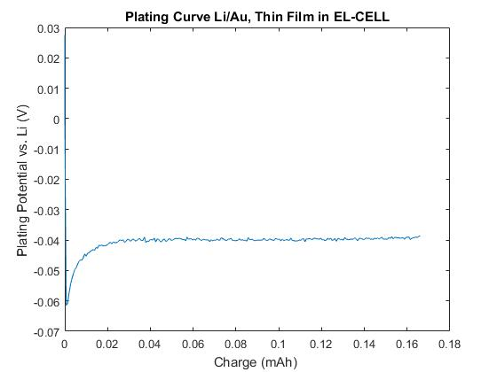
Thin Film Electrodeposition
EL-CELL
Notes:
-In both cases, we observed relatively conformal coating , little dendriteic behavior
Looking at the alloying peaks of each:
- Similar, EL CELL is non dedritiditc

Slide 9
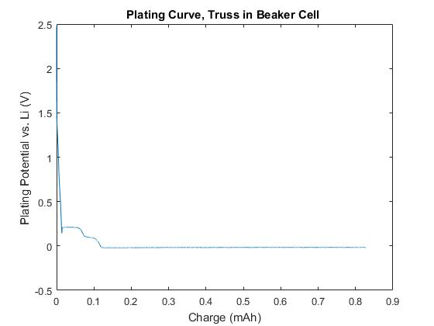
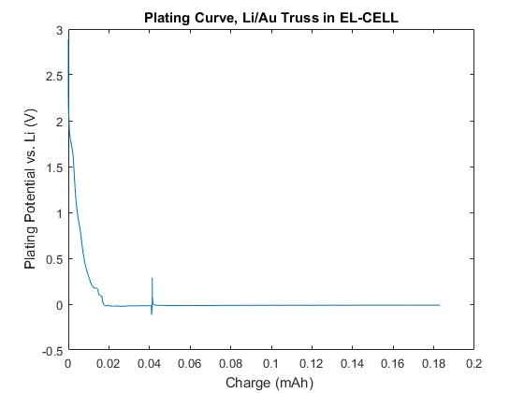
Nanotruss Electrodeposition
Beaker Cell
EL-CELL
Notes:
-not enough electrolyte in the truss
-cannot flood with electrolyte

Slide 10
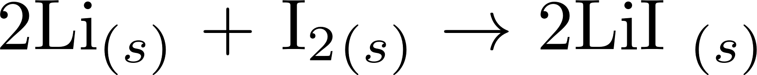
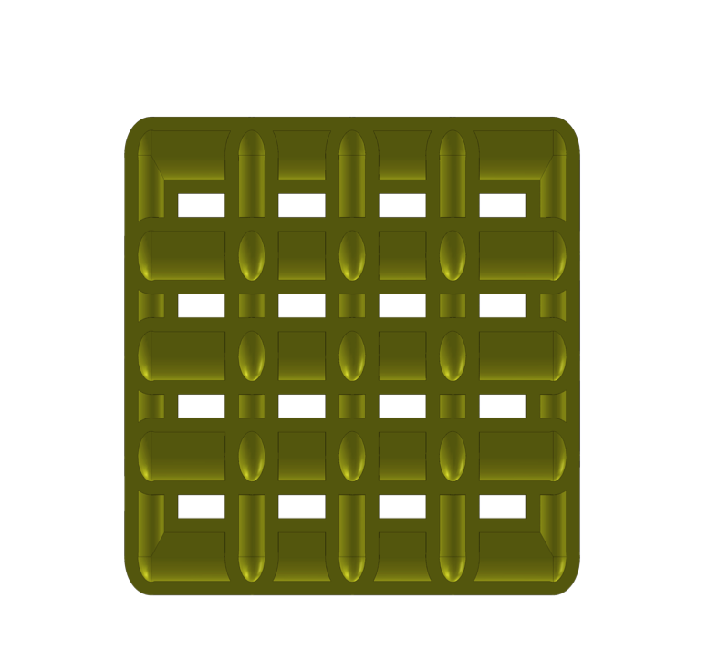

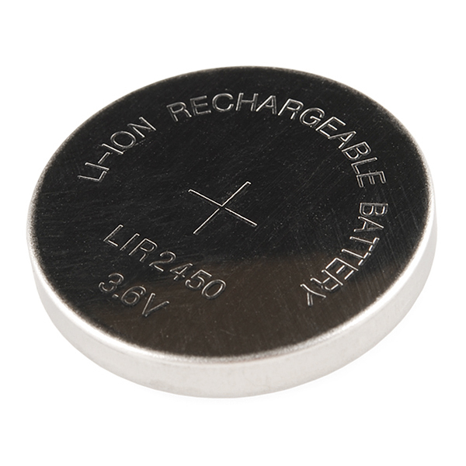

Future and Ongoing Steps…
Electroplate Li onto truss w/ coin cell
Fabricate a full cell
Implement design in secondary battery (LiPON w/ALD)
Ni/Au/Li Coated Truss
$$I_{2}/P2VP$$
Ni Substrate
Courtesy of Mike Citrin
10

Slide 11







THANK YOU!!
Mentors: Julia Greer, Mike Citrin
Heng Yang, Xiaoxing Xia
SURF Program
The Greer Group

Slide 12
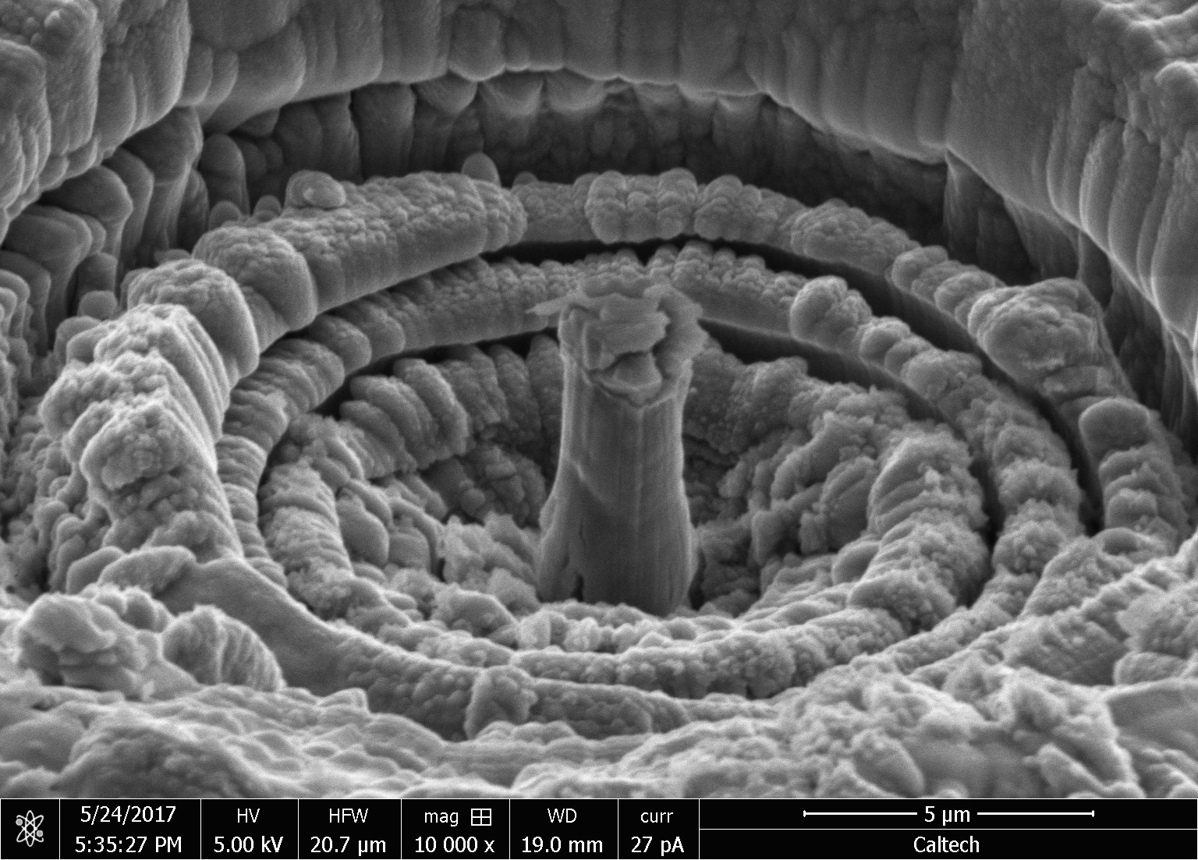
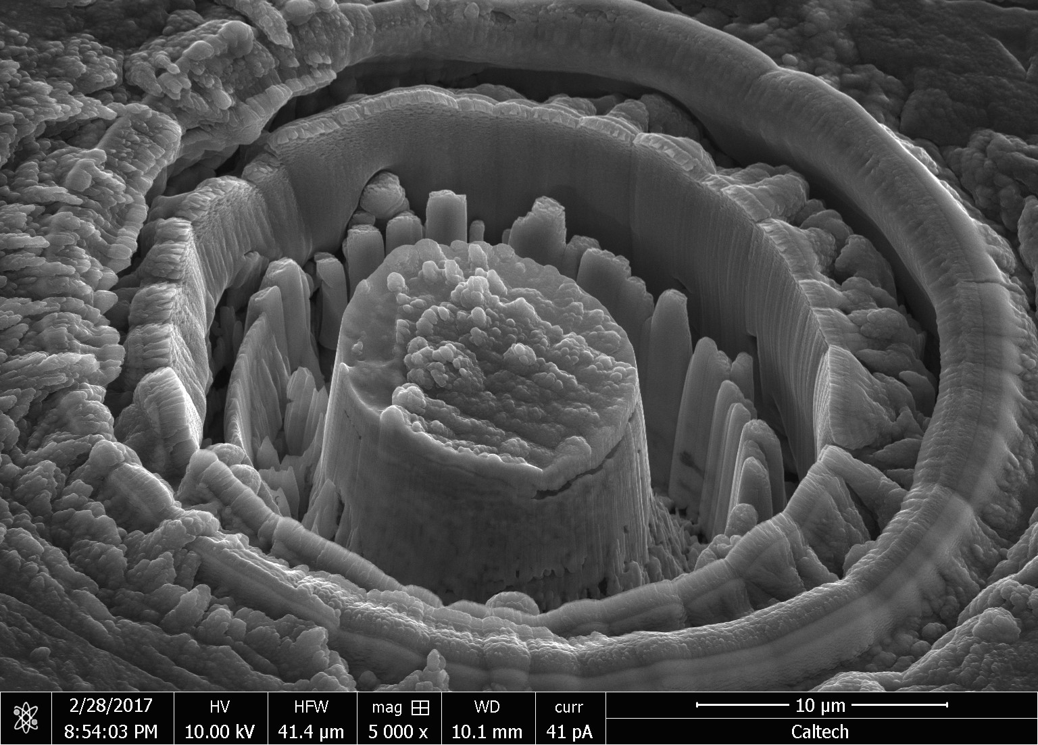
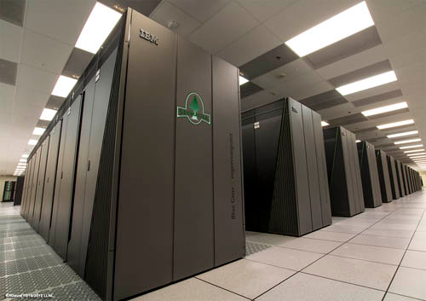
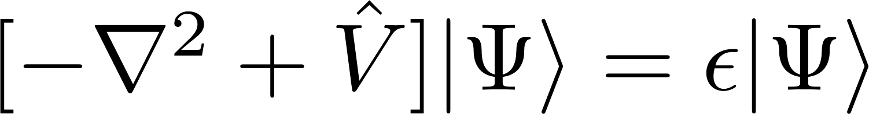

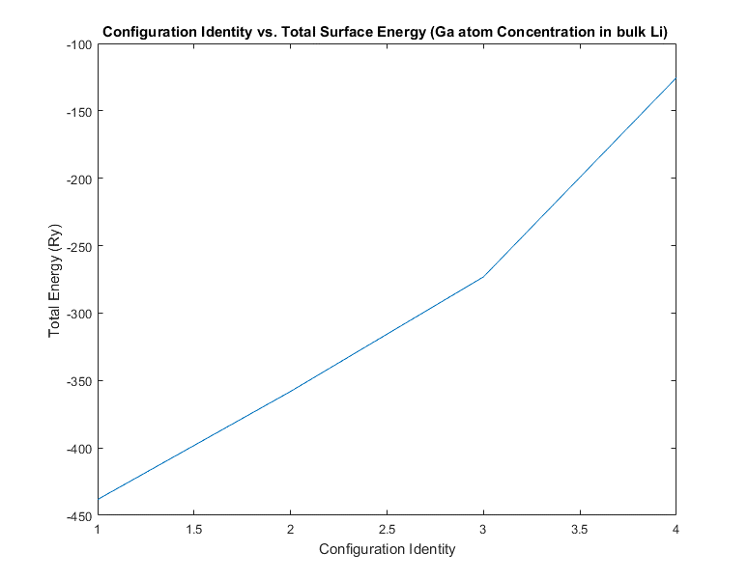

Understanding ${Ga}^{+}$ interactions with Nanoscale Li, via ab-initio Methods
Increasing J → Smoother surface
Materials Sci. and Engi., 2007, 32, 389-399
Hypothesis: Rough surface = higher surface energy. Increased J → Increased Ga surface concentration
Approach
+
computed for varied Ga configurations at surface
Hypothesis verified! But, is this a valid hypothesis??

